Slide 1
Lecture 2: Overfitting. Regularization
Generalizing regression
Overfitting
Cross-validation
L2 and L1 regularization for linear estimators
A Bayesian interpretation of regularization
Bias-variance trade-off

Slide 2
Recall: Overfitting
A general, HUGELY IMPORTANT problem for all machine learning algorithms
We can find a hypothesis that predicts perfectly the training data but
does not generalize well to new data
E.g., a lookup table!

Slide 3
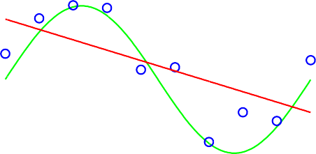
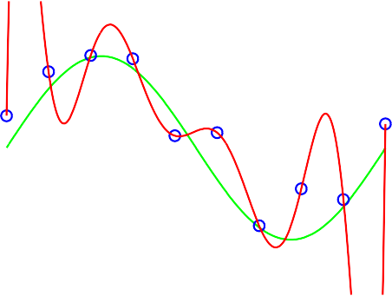
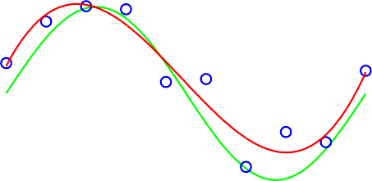
Overfitting example
M = 0
M = 1
1
1
t
t
0
0
−1
−1
0 1
0
1
x
x
M = 3
M = 9
1
1
t
t
0
0
−1
−1
0 1
0 1
x x
The higher the degree of the polynomial M , the more degrees of freedom, and the more capacity to “overfit” the training data
Typical overfitting means that error on the training data is very low, but error on new instances is high

Slide 4
Overfitting more formally
Assume that the data is drawn from some fixed, unknown probability distribution
Every hypothesis has a ”true” error J ∗(h), which is the expected error when data is drawn from the distribution.
Because we do not have all the data, we measure the error on the training set J_{D}(h)
Suppose we compare hypotheses h₁ and h₂ on the training set, and
J_{D}(h₁) < J_{D}(h₂)
If h₂ is ”truly” better, i.e. J ∗(h₂) < J ∗(h₁), our algorithm is overfitting.
We need theoretical and empirical methods to guard against it!

Slide 5
Typical overfitting plot
1
Training Test
ERMS
0.5
0
0 3 6 9
M
The training error decreases with the degree of the polynomial M , i.e.
the complexity of the hypothesis
The testing error, measured on independent data, decreases at first, then starts increasing
Cross-validation helps us:
Find a good hypothesis class (M in our case), using a validation set of data
Report unbiased results, using a test set, untouched during either parameter training or validation

Slide 6
Cross-validation
A general procedure for estimating the true error of a predictor
The data is split into two subsets:
A training and validation set used only to find the right predictor
A test set used to report the prediction error of the algorithm
These sets must be disjoint!
The process is repeated several times, and the results are averaged to provide error estimates.

Slide 7
Example: Polynomial regression
y
y
x
x
y
y
x
x

Slide 8


Leave-one-out cross-validation
For each order of polynomial, d:
Repeat the following procedure m times:
Leave out ith instance from the training set, to estimate the true prediction error; we will put it in a validation set
Use all the other instances to find best parameter vector, w_{d,i}
Measure the error in predicting the label on the instance left out, for the w_{d,i} parameter vector; call this J_{d,i}
This is a (mostly) unbiased estimate of the true prediction error
Compute the average of the estimated errors:
2. Choose the d with lowest average estimated error:
$$J\left(d\right)= \frac{1}{m}\sum_{i=1}^{m}{J_{d,i}}$$
$$d^{∗}=\arg{\min_{d} J(d)}$$

Slide 9
Estimating true error for d = 1
D = {(0.86, 2.49), (0.09, 0.83), (−0.85, −0.25), (0.87, 3.10), (−0.44, 0.87),
(−0.43, 0.02), (−1.10, −0.12), (0.40, 1.81), (−0.96, −0.83), (0.17, 0.43)}.
Iter | Dtrain | Dvalid | Error_{train} | Error_{valid} (J_{1,i})
1 2 3 4 5 6 7 8 9 10 | D − {(0.86, 2.49)} D − {(0.08, 0.83)} D − {(−0.85, −0.25)} D − {(0.87, 3.10)} D − {(−0.44, 0.87)} D − {(−0.43, 0.02)} D − {(−1.10, −0.12)} D − {(0.40, 1.81)} D − {(−0.96, −0.83)} D − {(0.17, 0.43)} | (0.86, 2.49) (0.09, 0.83) (−0.85, −0.25) (0.87, 3.10) (−0.44, 0.87) (−0.43, 0.02) (−1.10, −0.12) (0.40, 1.81) (−0.96, −0.83) (0.17, 0.43) | 0.4928 0.1995 0.3461 0.3887 0.2128 0.1996 0.5707 0.2661 0.3604 0.2138 | 0.0044 0.1869 0.0053 0.8681 0.3439 0.1567 0.7205 0.0203 0.2033 1.0490
mean: |  |  | 0.2188 | 0.3558

Slide 10
Leave-one-out cross-validation results
d | Error_{train} | Error_{valid} (J_{d})
1 | 0.2188 | 0.3558
2 | 0.1504 | 0.3095
3 | 0.1384 | 0.4764
4 | 0.1259 | 1.1770
5 | 0.0742 | 1.2828
6 | 0.0598 | 1.3896
7 | 0.0458 | 38.819
8 | 0.0000 | 6097.5
9 | 0.0000 | 6097.5
Typical overfitting behavior: as d increases,
training error decreases,
but the validation error decreases, then starts increasing again
Optimal choice: d = 2. Overfitting for d > 2

Slide 11
Estimating both hypothesis class and true error
Suppose we want to compare polynomial regression with some other algorithm
We chose the hypothesis class (i.e. the degree of the polynomial, d∗) based on the estimates J_{d}
Hence J_{d}∗ is not unbiased - our procedure was aimed at optimizing it
If we want to have both a hypothesis class and an unbiased error estimate, we need to tweak the leave-one-out procedure a bit

Slide 12
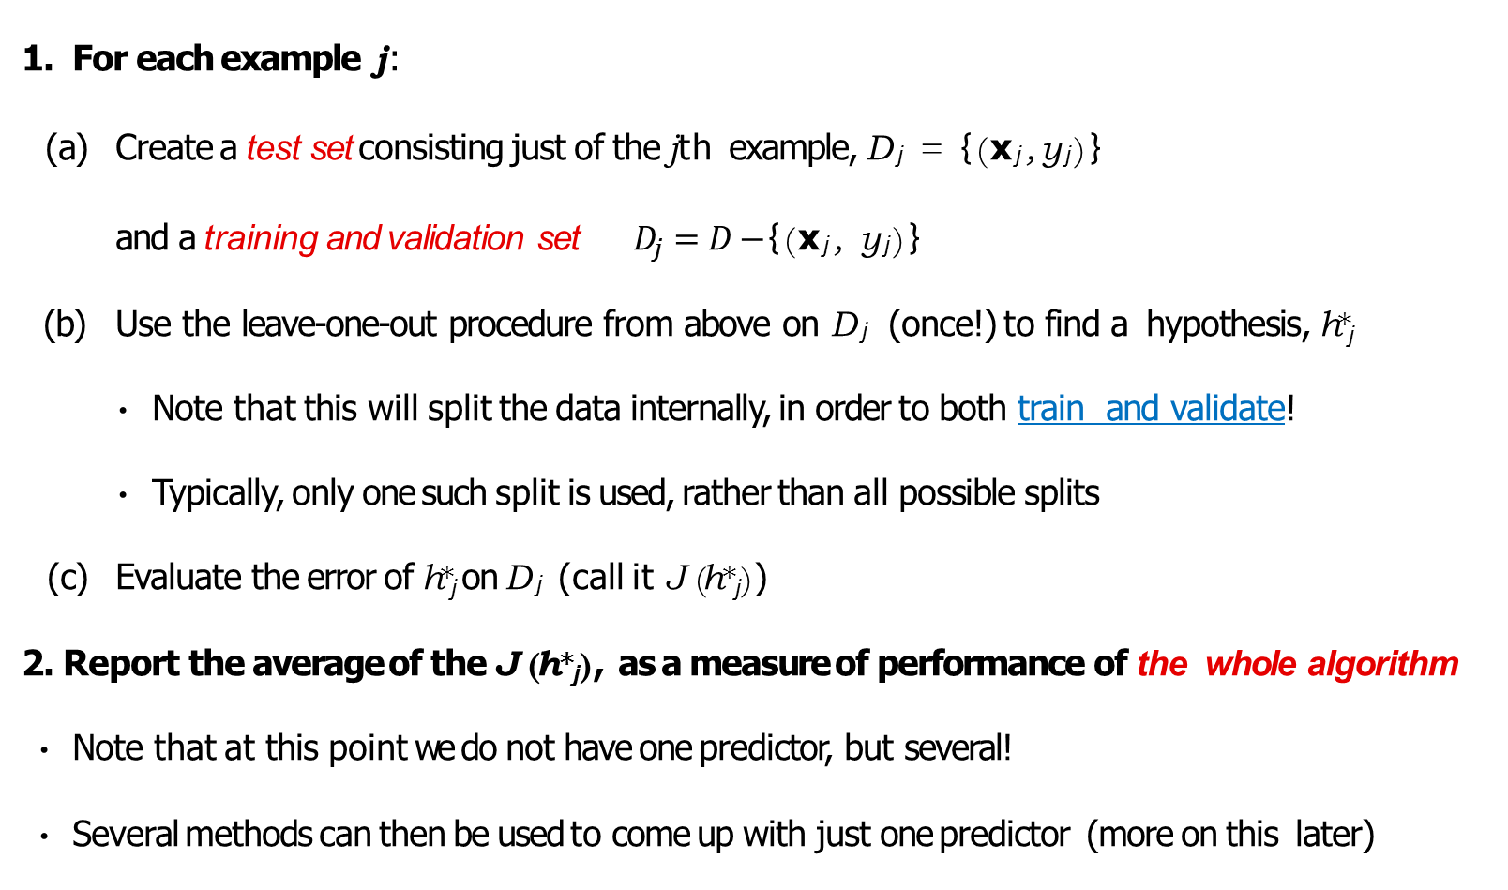
Cross-validation with validation and testing sets
For each example j:
Create a test set consisting just of the jth example, D_{j} = {(x_{j}, y_{j})}
and a training and validation set $D_{j}=D−${(x_{j}, y_{j})}
Use the leave-one-out procedure from above on D_{j} (once!) to find a hypothesis, h∗_{j}
Note that this will split the data internally, in order to both train and validate!
Typically, only one such split is used, rather than all possible splits
Evaluate the error of h∗_{j} on D_{j} (call it J (h∗_{j} ))
2. Report the average of the J (h∗_{j} ), as a measure of performance of the whole algorithm
Note that at this point we do not have one predictor, but several!
Several methods can then be used to come up with just one predictor (more on this later)

Slide 13
Summary of leave-one-out cross-validation
A very easy to implement algorithm
Provides a great estimate of the true error of a predictor
It can indicate problematic examples in a data set (when using multiple algorithms)
Computational cost scales with the number of instances (examples), so it can be prohibitive, especially if finding the best predictor is expensive
We do not obtain one predictor, but many!
Alternative: k-fold cross-validation: split the data set into k parts, then proceed as above.

Slide 14
Regularization
Remember the intuition: complicated hypotheses lead to overfitting
Idea: change the error function to penalize hypothesis complexity:
J (w) = J_{D}(w) + λJ_{pen}(w)
This is called regularization in machine learning and shrinkage in statistics
λ is called regularization coefficient and controls how much we value fitting the data well, vs. a simple hypothesis

Slide 15
Regularization for linear models
A squared penalty on the weights would make the math work nicely in our case
1 λ
2
T T
(Φw − y) (Φw − y) + w w
2
This is also known as L₂ regularization, or weight decay in neural networks
By re-grouping terms, we get:
1
T T T T T T
J_{D}(w) = ₂(w (Φ Φ + λI)w − w Φ y − y Φw + y y)
Optimal solution (obtained by solving ∇_{w}J_{D}(w) = 0)
w = (Φ^{T} Φ + λI)⁻¹Φ^{T} y

Slide 16
What L₂ regularization does
1
λ
T T T −1 T
arg min (Φw − y) (Φw − y) + w w = (Φ Φ + λI) Φ y
w
2 2
If λ = 0, the solution is the same as in regular least-squares linear regression
If λ → ∞, the solution w → 0
Positive λ will cause the magnitude of the weights to be smaller than in the usual linear solution
This is also called ridge regression, and it is a special case of Tikhonov regularization (more on that later)
A different view of regularization: we want to optimize the error while keeping the L₂ norm of the weights, w^{T} w, bounded.

Slide 17
Detour: Constrained optimization
Suppose we want to find
min f (w)
w
such that g(w)=0
Use the concept of contour line, e.g., f(x)=k or g(x) = c
Fact 1: The gradient of f evaluated at a point x0 always gives a vector perpendicular to the contour line passing through that point.
Fact 2: When the contour of two functions are tangent, their gradient vectors are parallel, which means that they differ by a multiplicative constant, say λ, i.e.,
∇f (x) = λ ∇g(x)
g(x) = c
∇f (x)
∇g(x)
g(x) = 0

Slide 18
Digression: Lagrange multipliers
∇f (x)
x_{A}
∇g(x)
g(x) = 0
∇g has to be orthogonal to the constraint surface (red curve)
At the optimum, ∇f and ∇g have to be parallel (in same or opposite direction)
Hence, there must exist some λ ∈ R such that ∇f - λ∇g = 0
Lagrangian function: L(x, λ) = f (x) - λg(x) λ is called Lagrange multiplier
We obtain the solution to our optimization problem by setting both
∂L
∇_{x}L = 0 and _{∂λ} = 0

Slide 19
Digression: Inequality constraints
Suppose we want to find
min f (w)
w
such that g(w) ≥ 0
∇f (x)
x_{A}
∇g(x)
x_{B}
g(x) > 0
g(x) = 0
In the interior (g (x )> 0) - simply find ∇f (x) = 0
On the boundary (g(x = 0)) - same situation as before, but the sign matters this time
For minimization, we want ∇f pointing in the same direction as ∇g

Slide 20
Digression: KKT conditions
Based on the previous observations, let the Lagrangian be
L(x, λ) =f (x) − λg(x)
We minimize L wrt x subject to the following constraints:
λ | ≥ | 0
g(x) | ≥ | 0
λg(x) | = | 0
These are called Karush-Kuhn-Tucker (KKT) conditions

Slide 21
L₂ Regularization for linear models revisited
Optimization problem: minimize error while keeping norm of the weights bounded
min J_{D}(w) =
w
such that w^{T} w ≤ η
T
min(Φw − y) (Φw − y)
w
The Lagrangian is:
T T T
L(w, λ) = J_{D}(w) − λ(η − w w) = (Φw − y) (Φw − y) + λw w − λη

Slide 22
Visualizing regularization (2 parameters)
w₂
_{w}y
w₁
w∗ = (Φ^{T} Φ + λI)⁻¹Φy

Slide 23
Pros and cons of L₂ regularization
If λ is at a “good” value, regularization helps to avoid overfitting
Choosing λ may be hard: cross-validation is often used
If there are irrelevant features in the input (i.e. features that do not affect the output), L₂ will STILL give them small, but non-zero weights.
Ideally, irrelevant input should have weights exactly equal to 0.

Slide 24
L₁ Regularization for linear models
Instead of requiring the L₂ norm of the weight vector to be bounded, make the requirement on the L₁ norm:
T
min J_{D}(w) = min(Φw − y) (Φw − y)
w w
such that
n
|w | ≤ η
Σ
i
i=1
This yields an algorithm called Lasso (Tibshirani, 1996)

Slide 25
Solving L₁ regularization
The optimization problem is a quadratic program
There is one constraint for each possible sign of the weights (2^{n}constraints for n weights)
For example, with two weights:
min
w₁,w₂
m
2
(y_{j} − w₁x₁ − w₂x₂)
Σ
j=1
such that w₁ + w₂ ≤ η
w₁ − w₂ ≤ η
−w₁ + w₂ ≤ η
−w₁ − w₂ ≤ η
Solving this program directly can be done for problems with a small number of inputs

Slide 26
Visualizing L₁ regularization
w₂
_{w}y
w₁
If λ is big enough, the circle is very likely to intersect the diamond at one of the corners
This makes L₁ regularization much more likely to make some weights
exactly 0

Slide 27
Pros and cons of L₁ regularization
If there are irrelevant features, Lasso is likely to make their weights 0, while L₂ is likely to just make all weights small
Lasso is biased towards providing sparse solutions in general
Lasso optimization is computationally more expensive than L₂
More efficient solution methods have to be used for large numbers of inputs (e.g. least-angle regression, 2003).
L₁ methods of various types are very popular

Slide 28
Example of L1 vs L2 effect
•
lcavol
• • •
• • lcavol
0.6
• •
• •
0.6
• • •
• • • • •
• • •
•
•
•
•
•
0.4
•
•
•
0.4
•
•
•
•
svi
•
svi
• • • •• •• ••
lweight
• • • • •• • lweight
Coefficients
•
•
• • • • • •
pgg45
lbph
Coefficients
•
• •
• • •
• • •
pgg45
lbph
•
• • • •
• • • • •
• •
•
•
• • •
• •
• • • •
0.2
•
•
•
• •• •
• •• • •
• • • •• •• • • •
0.2
•
•
• • • •• • • • •
• • • • • • •
•
•
• • • • •
• • • •
• • • • • • •
•
•
• •
• •
• • • • • • • •• • • •
•
•
•
•• •• • •• •• • • • • •
•
•
• • •
• •• •• • • • • • • • •• • • •
• • • • • • •
• •• •
0.0
•
•• •• • • • • • • • •
• •
0.0
•
• • •
• • • • • • • • • • • • • • • • • • • • • • • •
• • •
gleason
• •
• • •
gleason
• • •
• •• •• •
• • •
• • •
• • • • •
•
age
•
• • age
•
•
•
•
lcp
-0.2
• •
•
-0.2
lcp
0
2
4
6
8
0.0
0.2
0.4
0.6 0.8
1.0
Degrees of Freedom
Shrinkage Factor s
Note the sparsity in the coefficients induces by L₁
Lasso is an efficient way of performing the L₁ optimization

Slide 29
Bayesian view of regularization
Start with a prior distribution over hypotheses
As data comes in, compute a posterior distribution
We often work with conjugate priors, which means that when combining the prior with the likelihood of the data, one obtains the posterior in the same form as the prior
Regularization can be obtained from particular types of prior (usually, priors that put more probability on simple hypotheses)
E.g. L₂ regularization can be obtained using a circular Gaussian prior for the weights, and the posterior will also be Gaussian
E.g. L₁regularization uses double-exponential prior (see (Tibshirani, 1996))

Slide 30
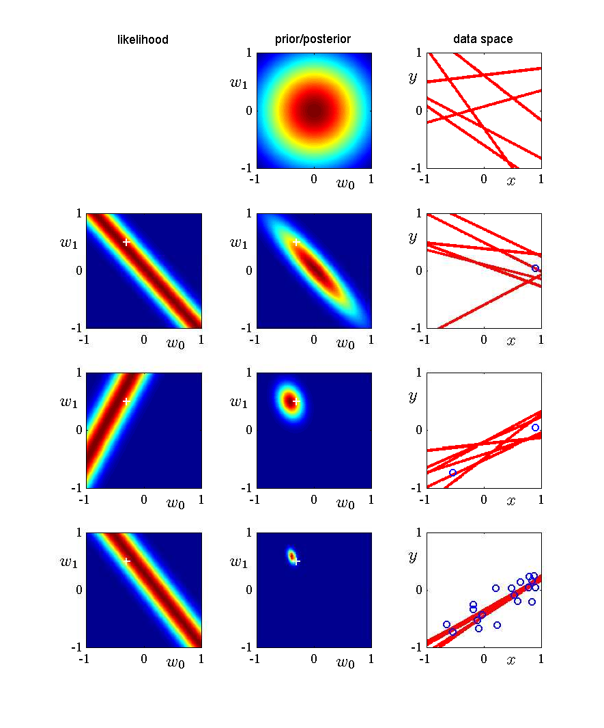
Bayesian view of regularization
Prior is round Gaussian
Posterior will be skewed by the data

Slide 31
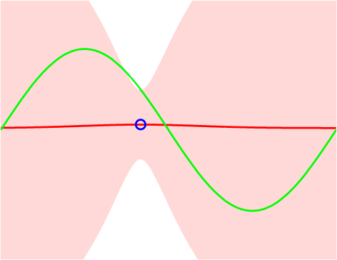
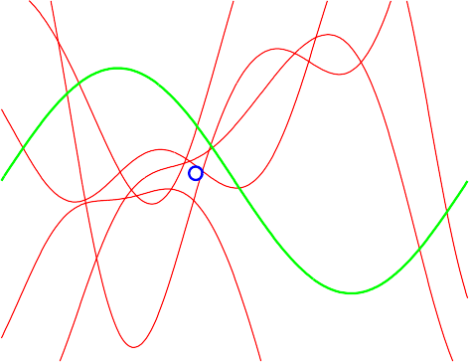
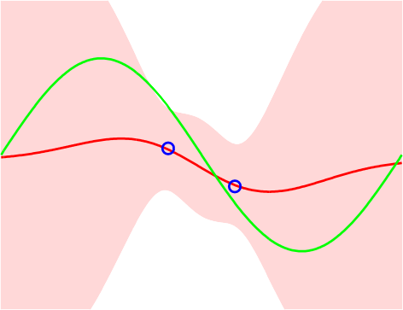
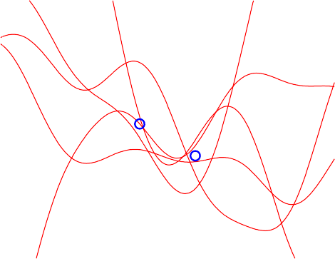
What does the Bayesian view give us?
1
1
t
t
0
0
−1
−1
0
x
1
0
x
1
1
1
t
t
0
0
−1
−1
0
Circles are data points
x
1
0
x
1
Green is the true function
Red lines on right are drawn from the posterior distribution

Slide 32
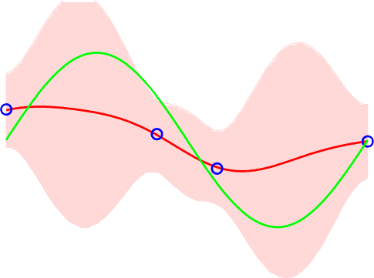
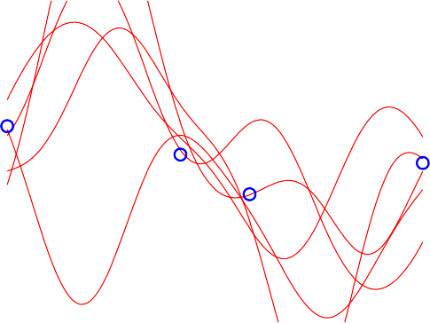
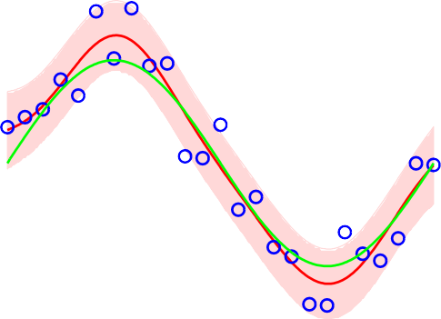
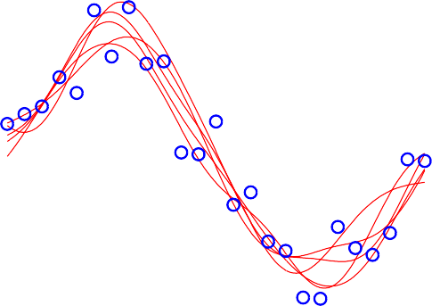
What does the Bayesian view give us?
1
1
t
t
0
0
−1
−1
0
x
1
0
x
1
1
1
t
t
0
0
−1
−1
0 1
0
1
x x
Functions drawn from the posterior can be very different
Uncertainty decreases where there are data points

Slide 33
What does the Bayesian view give us?
Uncertainty estimates, i.e. how sure we are of the value of the function
These can be used to guide active learning: ask about inputs for which the uncertainty in the value of the function is very high
In the limit, Bayesian and maximum likelihood learning converge to the same answer
In the short term, one needs a good prior to get good estimates of the parameters
Sometimes the prior is overwhelmed by the data likelihood too early.
Using the Bayesian approach does NOT eliminate the need to do cross- validation in general
More on this later...

Slide 34
The anatomy of the error of an estimator
Suppose we have examples (x, y) where y = f (x)+e and e is Gaussian noise with zero mean and standard deviation σ
We fit a linear hypothesis h(x) = w^{T} x, such as to minimize sum-squared error over the training data:
m
(y − h(x ))
2
Σ
i i
i=1
Because of the hypothesis class that we chose (hypotheses linear in the parameters) for some target functions f we will have a systematic prediction error
Even if f were truly from the hypothesis class we picked, depending on the data set we have, the parameters w that we find may be different; this variability due to the specific data set on hand is a different source of error

Slide 35
Bias-variance analysis
Given a new data point x, what is the expected prediction error?
Assume that the data points are drawn independently and identically distributed (i.i.d.) from a unique underlying probability distribution P ((x, y)) = P (x)P (y|x)
The goal of the analysis is to compute, for an arbitrary given point x,
where y is the value of x in a data set, and the expectation is over all training sets of a given size, drawn according to P
For a given hypothesis class, we can also compute the true error, which is the expected error over the input distribution:
(if x continuous, sum becomes integral with appropriate conditions).
We will decompose this expectation into three components

Slide 36
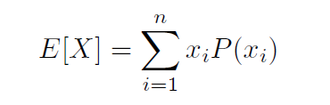
Recall: Statistics 101
Let X be a random variable with possible values x_{i}, i = 1 . . . n and with probability distribution P (X)
The expected value or mean of X is:
If X is continuous, roughly speaking, the sum is replaced by an integral, and the distribution by a density function
The variance of X is:
V ar[X]
2
= E[(X − E(X)) ]
= E[X²] − (E[X])²

Slide 37
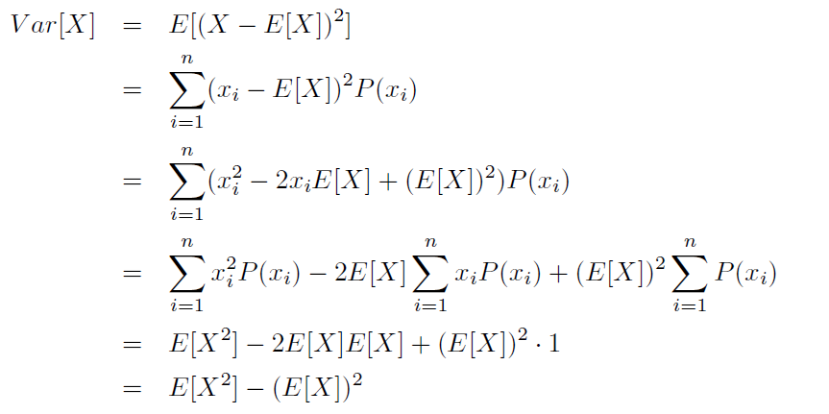
The variance lemma
We will use the form:
Use the form
E[X²] = (E[X])² + V ar[X]

Slide 38
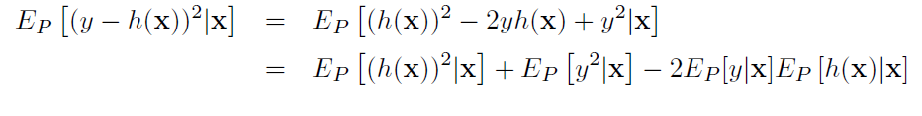
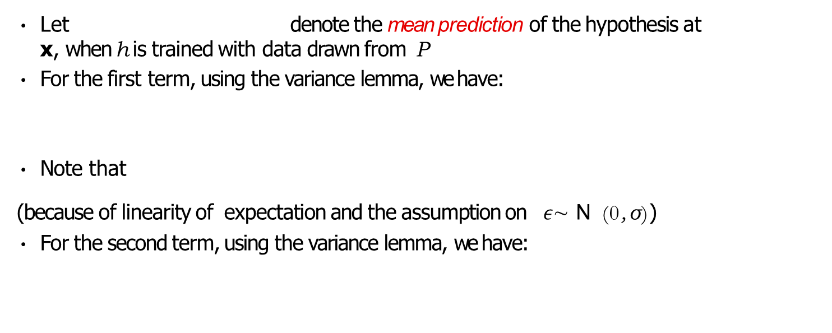
Bias-variance decomposition
Simple algebra:
Let denote the mean prediction of the hypothesis at
x, when h is trained with data drawn from P
For the first term, using the variance lemma, we have:
Note that
(because of linearity of expectation and the assumption on $ε$∼ N (0, σ))
For the second term, using the variance lemma, we have:

Slide 39
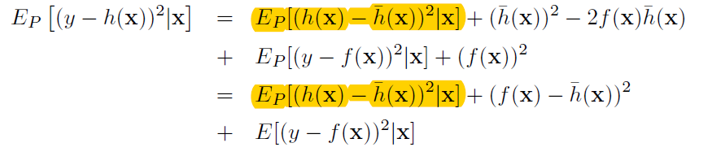


Bias-variance decomposition (2)
Putting everything together, we have:
The first term, is the variance of the hypothesis
h at x, when trained with finite data sets sampled randomly from P
The second term, , is the squared bias (or systematic error) which is associated with the class of hypotheses we are considering
The last term, E[(y − f (x))²|x] is the noise, which is due to the problem at hand, and cannot be avoided

Slide 40
Error decomposition
0.15
0.12
(bias)² variance
(bias)² + variance test error
0.09
0.06
0.03
0
−3
−2
−1
0
1
2
ln λ
The bias-variance sum approximates well the test error over a set of 1000 points
x-axis measures the hypothesis complexity (decreasing left-to-right)
Simple hypotheses usually have high bias (bias will be high at many points, so it will likely be high for many possible input distributions)
Complex hypotheses have high variance: the hypothesis is very dependent on the data set on which it was trained.

Slide 41
Bias-variance trade-off
Typically, bias comes from not having good hypotheses in the considered class
Variance results from the hypothesis class containing “too many” hypotheses
MLE estimation is typically unbiased, but has high variance
Bayesian estimation is biased, but typically has lower variance
Hence, we are faced with a trade-off:
Choose a more expressive class of hypotheses → generate higher variance, or
Choose a less expressive class, → generate higher bias
Making the trade-off has to depend on the amount of data available to fit the parameters (data usually mitigates the variance problem)

Slide 42
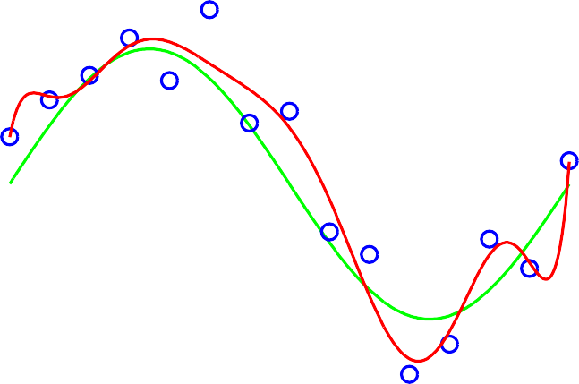
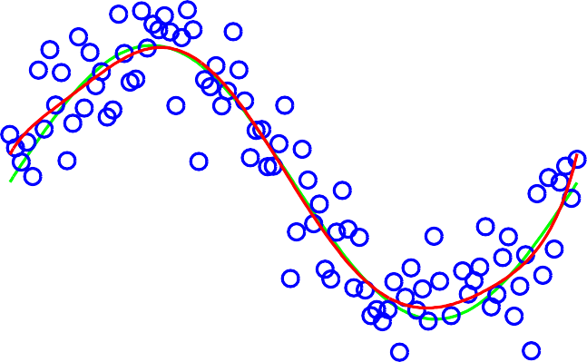
More on overfitting
Overfitting depends on the amount of data, relative to the complexity of the hypothesis
With more data, we can explore more complex hypotheses spaces, and still find a good solution
N = 15
N = 100
1
1
t
t
0
0
−1
−1
0 1
0
1
x
x

